Slide 1
IoT & Sensor Data
Shabab Akhter
External Lecturer
RUC
Shabab Akhter | Ext. Lecturer | RUC

Slide 2
Contents
Background & fundamentals of IoT & sensor data analysis
What is IoT?
What are the key challenges with IoT data?
Exercise - load sensor data and visualize
IoT Connectivity
Protocols
Data & Analytics
MQTT
Exercise on MQTT
Predictive maintenance
ML modelling for predictive maintenance
Evaluation metrics
Exercise - predictive maintenance modelling
Real world considerations
IoT infrastructure & Edge computing
Shabab Akhter | Ext. Lecturer | RUC

Slide 3
Contents
Background & fundamentals of IoT & sensor data analysis
What is IoT?
What are the key challenges with IoT data?
Exercise - load sensor data and visualize
IoT Connectivity
Protocols
Data & Analytics
MQTT
Exercise on MQTT
Predictive maintenance
ML modelling for predictive maintenance
Evaluation metrics
Exercise - predictive maintenance modelling
Real world considerations
IoT infrastructure & Edge computing
Shabab Akhter | Ext. Lecturer | RUC

Slide 4
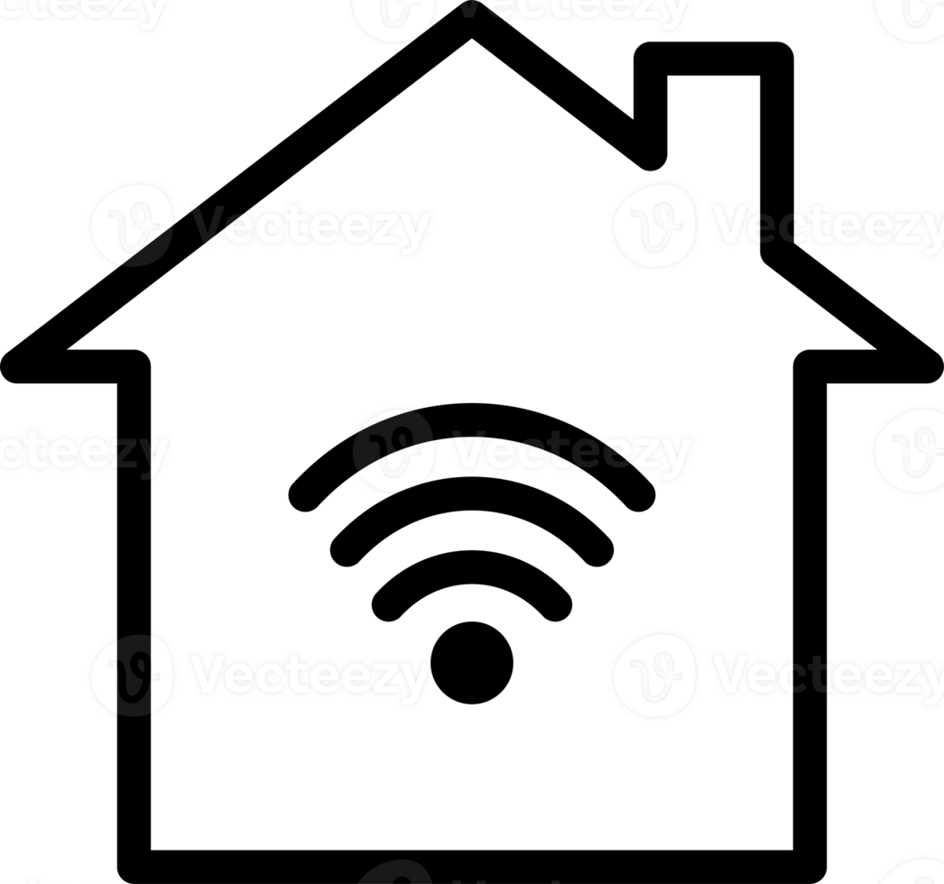

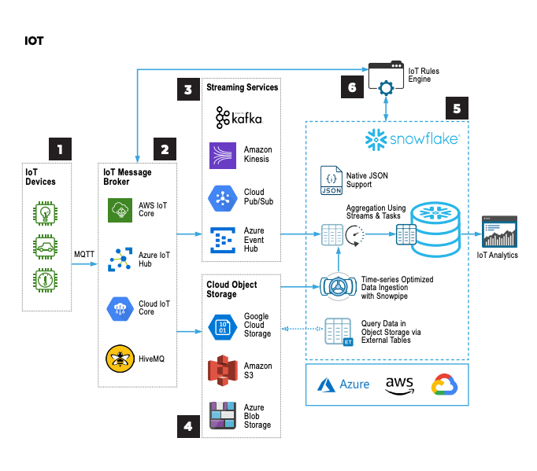


Intro to IoT
The Internet of Things (IoT) refers to a network of interconnected devices and objects embedded with sensors and software that communicate and share data.
They are mostly used for applications such as:
Smart Homes: IoT enables automation of home devices like lights, thermostats, and security cameras, improving energy efficiency, security, and convenience.
Healthcare & Remote Monitoring: IoT devices track patient health data in real time, supporting better disease management and reducing hospital visits.
Industrial IoT (IIoT): In industries, IoT monitors machines, tracks inventory, and optimizes production, increasing efficiency and reducing downtime.
Smart Cities: IoT helps manage traffic, waste, and energy systems, reducing congestion, improving services, and saving resources.
Key Technologies:
Sensors
Data acquisition
Cloud/Edge computing
Machine learning for predictive analytics
Shabab Akhter | Ext. Lecturer | RUC

Slide 5
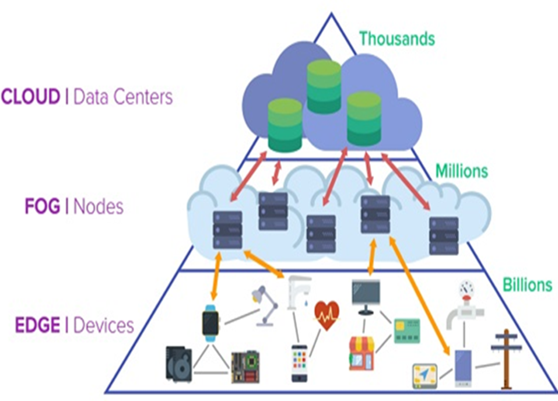
IoT Computing Layers
Cloud computing layer
Aggregates data summaries from multiple fog nodes
Performs deeper analysis on large data sets and sends application rules to fog nodes
Fog computing layer
Transient storage for immediate data
Real-time analytics and control based on application rules provided by cloud layer
Edge computing layer
Capture user interactions and send feeds to Fog node
Performs intelligent actions based on real-time control signals from fog nodes
Shabab Akhter | Ext. Lecturer | RUC

Slide 6
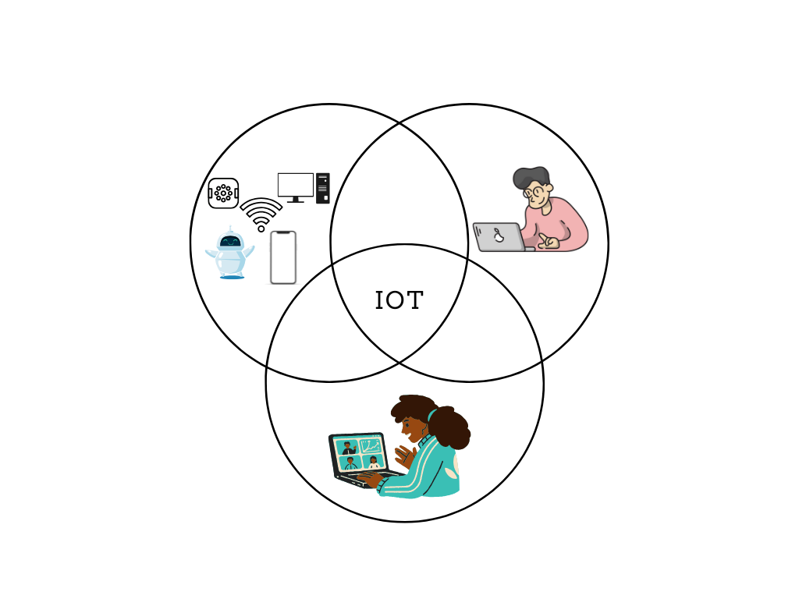
Connection Types in IoT
Machine-to-people (M2P): Connection for transferring information between a thing and a person.
Machine-to-machine (M2M): Connect 'things' over a network, including sensors, robots, computers, and mobile devices.
People-to-People (P2P): Connections between one person and another through video, mobile devices, and social networks, called collaboration.
Shabab Akhter | Ext. Lecturer | RUC

Slide 7
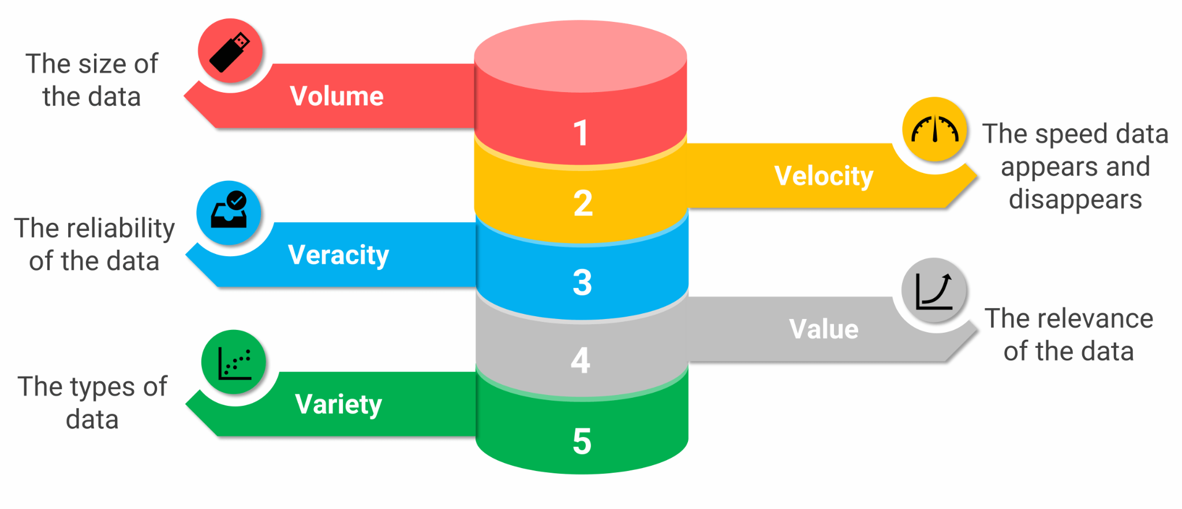
Characteristics of IoT Data
Shabab Akhter | Ext. Lecturer | RUC
Notes:
Volume: The amounts of collected data are continuously increasing.
Velocity: One of the most prominent features of IoT is its real-time or near real-time communication of information about the “connected things”.
Veracity: The raw data collected is often dirty, with missing values, redundancies and wrong values. Cleansing and quality enhancement may be necessary before the data is used.
Variety: Smart-X scenarios are in many cases also characterized by the variety of data sources and data to be stored and processed.

Slide 8
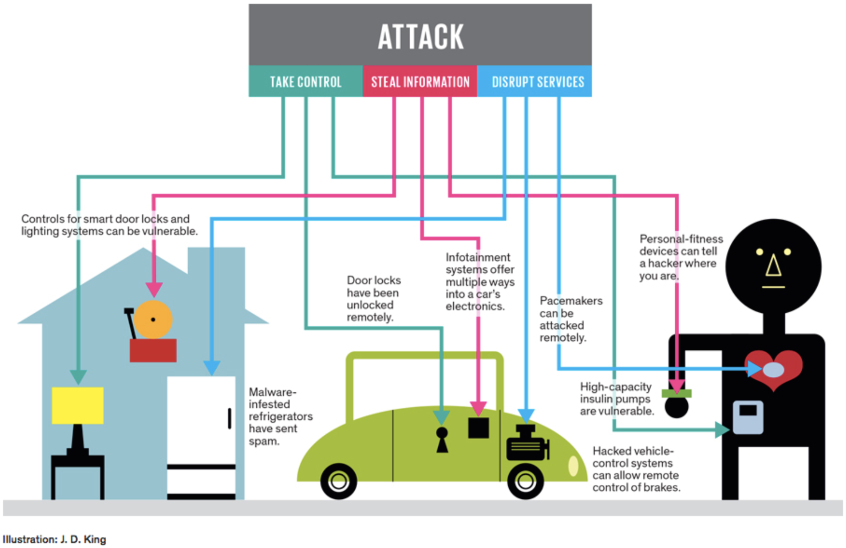
The Challenge with IoT Data
Data Volume: IoT devices generate vast amounts of data, making storage and processing a challenge.
Data Quality: Raw sensor data may be noisy, incomplete, or erroneous, affecting analysis accuracy.
Data Security: IoT devices are vulnerable to cyberattacks, posing privacy and security risks.
Data Integration: Devices may use different data formats and protocols, requiring complex integration.
Real-Time Processing: Many applications require real-time data processing, demanding efficient systems.
Scalability: IoT systems must handle millions of devices and vast amounts of data.
Shabab Akhter | Ext. Lecturer | RUC

Slide 9
Contents
Background & fundamentals of IoT & sensor data analysis
What is IoT?
What are the key challenges with IoT data?
Exercise - load sensor data and visualize
IoT Connectivity
Protocols
Data & Analytics
MQTT
Exercise on MQTT
Predictive maintenance
ML modelling for predictive maintenance
Evaluation metrics
Exercise - predictive maintenance modelling
Real world considerations
IoT infrastructure & Edge computing
Shabab Akhter | Ext. Lecturer | RUC

Slide 10
Connectivity is required to perform IoT Data Analytics
Purpose: To harvest value out of IoT data
Requirements for IoT applications
Real-time monitoring of what “things” are doing, their operating conditions, their issues, their load, their configuration, etc.
Predictive maintenance: fix before “things” break.
Optimization: configuration, interaction with humans, energy efficiency, most suitable “things” for different uses.
Analytics to find out the current shortcomings to design next versions of “things”.
Shabab Akhter | Ext. Lecturer | RUC

Slide 11
Simplified IoT Layer Architecture
IoT data management and computing stack
Core IoT
functional stack
IoT data Analytics
Applications
Cloud
Layer 3
Security
Layer 2
Communication
Fog
Layer 1
Things: Sensors and actuators
Edge
Shabab Akhter | Ext. Lecturer | RUC
Notes:
IoT could also be looked at as simply an interaction between the physical and digital world
There are many different types of sensors in an IoT system. Flow sensors, temperature sensors, voltage sensors, humidity sensors, and the list goes on.
an actuator operates in the reverse direction of a sensor. It takes an electrical input and turns it into physical action

Slide 12
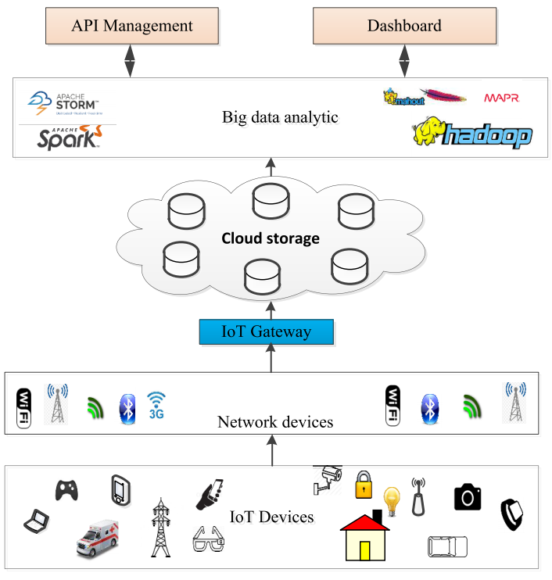
Cloud Based IoT Data Analytics
Many more available
Services
Google IoT Core
IBM Cloud
Amazon EC2
MS Azure
…
Types of clouds
Public
Private
Hybrid
Shabab Akhter | Ext. Lecturer | RUC

Slide 13
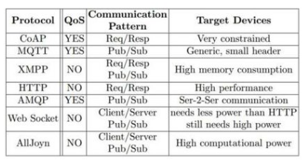
Typical IoT Application Protocols
REST
An architectural style for developing web services.
CoAP
Constrained Application Protocol
MQTT
Message Queuing Telemetry Transport
XMPP
Extensible Messaging and Presence Protocol
AMQP
Advanced Message Queuing Protocol
WebSocket
Computer Communications Protocol
Shabab Akhter | Ext. Lecturer | RUC

Slide 14
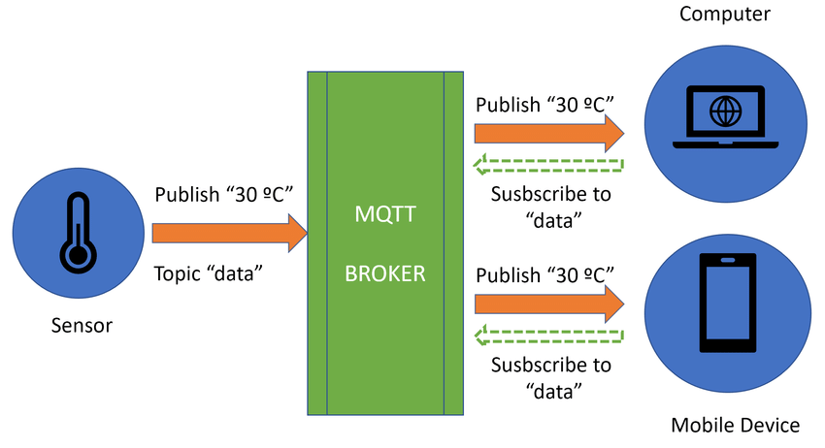

Examples of Messaging Technologies: MQTT
Topic: temperature
Shabab Akhter | Ext. Lecturer | RUC

Slide 15
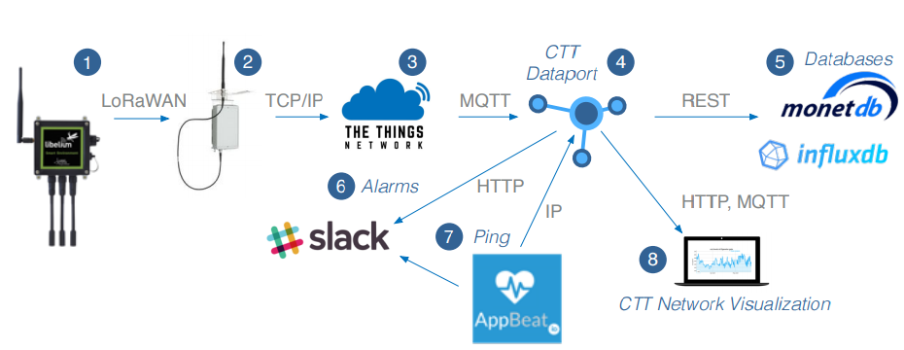
Protocols Used in A Full IoT Application
Shabab Akhter | Ext. Lecturer | RUC

Slide 16
Exercise – use MQTT brokers
Let us see how to setup an MQTT broker and send messages
Now, try yourself:
Use the diabetes.csv dataset to do the following:
Select the following 4 attributes (3 features + 1 class label) :
Glucose, BloodPressure, Insulin, Outcome
Normalize Glucose, BloodPressure and Insulin to [0, 1] using MinMax.
Store the new data (3 normalized features + 1 class label) in another dataset S.
Modify the MQTT example to do the following:
The publisher publishes records in S continuously. When it reaches the end of S, it continues to send from the beginning again.
The subscriber continuously receives the data. For each latest record r received, apply the 3NN classification to the last 5 records before r, and compare the classification result with the Outcome label in r.
Repeat this for 1000 times, and report the number of correct classifications.
Shabab Akhter | Ext. Lecturer | RUC

Slide 17
Contents
Background & fundamentals of IoT & sensor data analysis
What is IoT?
What are the key challenges with IoT data?
Exercise - load sensor data and visualize
IoT Connectivity
Protocols
Data & Analytics
MQTT
Exercise on MQTT
Predictive maintenance
ML modelling for predictive maintenance
Evaluation metrics
Exercise - predictive maintenance modelling
Real world considerations
IoT infrastructure & Edge computing
Shabab Akhter | Ext. Lecturer | RUC

Slide 18

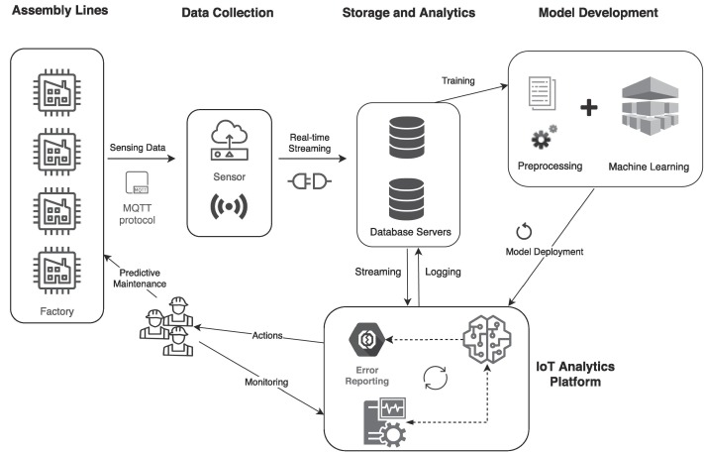


Predictive Maintenance
Predictive Maintenance (PdM) refers to the practice of using data from IoT devices and sensors to predict when equipment or machinery will fail, allowing for proactive maintenance before any issues arise. This approach helps avoid unplanned downtime and reduces maintenance costs.
They are mostly used for applications such as:
Automotive:IoT devices track the performance of vehicles, including engine health, tire pressure, and battery status. Predictive maintenance in this sector helps avoid breakdowns by predicting component failure and recommending timely repairs, extending vehicle lifespan and improving safety.
Energy & Utilities: In power plants and energy grids, IoT sensors monitor turbines, transformers, and other equipment. Predictive maintenance predicts potential failures in critical infrastructure, ensuring smooth operations and preventing energy outages.
Aerospace: Aircraft and engine components are equipped with IoT sensors that monitor conditions such as pressure, temperature, and vibration. Predictive maintenance in aviation ensures timely inspections and repairs, enhancing safety and reducing operational disruptions.
Key Technologies:
IoT Sensors
Data acquisition
Cloud/Edge computing
Machine learning for predictive analytics
Shabab Akhter | Ext. Lecturer | RUC

Slide 19
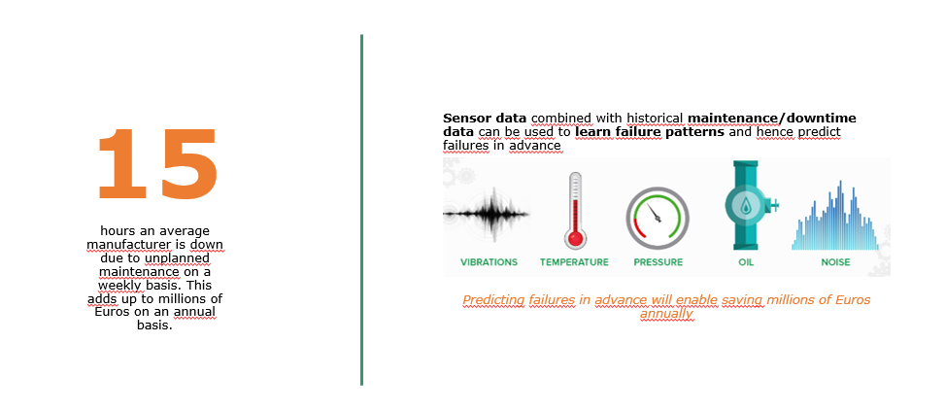
Predictive maintenance is critical in manufacturing
Shabab Akhter | Ext. Lecturer | RUC

Slide 20
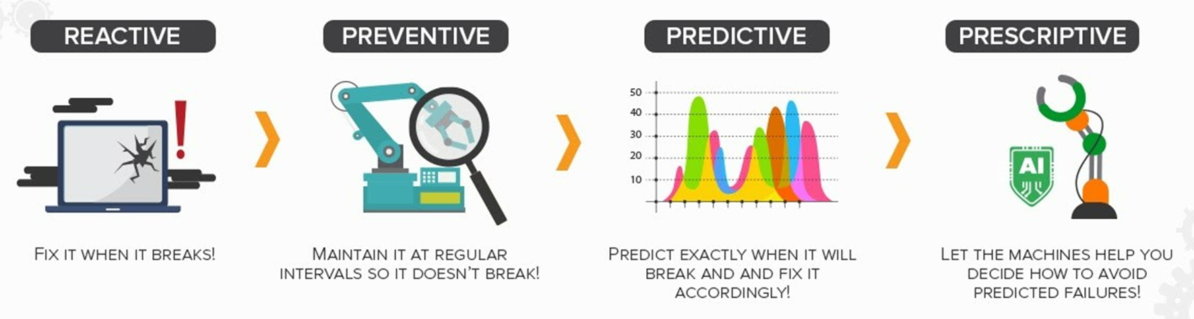
Different types of maintenance
Shabab Akhter | Ext. Lecturer | RUC

Slide 21
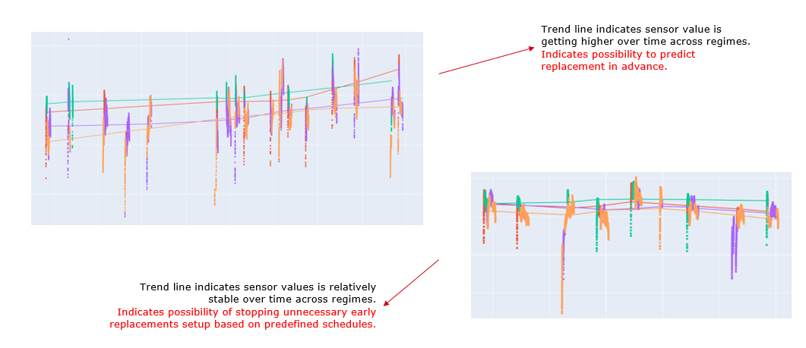
Real life sensor examples
Shabab Akhter | Ext. Lecturer | RUC

Slide 22
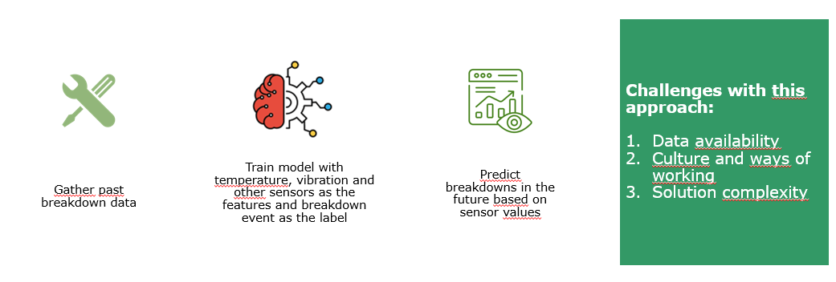
Reality is challenging
Shabab Akhter | Ext. Lecturer | RUC

Slide 23
We can use unsupervised methods instead
First the data needs to be treated using methods such as Dimensionality Reduction
Principal Component Analysis (PCA): Reducing the number of features while retaining most of the variance in the data.
t-SNE or UMAP: Visualizing high-dimensional data or reducing dimensionality in a way that highlights important patterns.
Importance of Dimensionality Reduction
Reduces Computational Complexity: Minimizes processing time and resource usage by working with fewer features.
Mitigates Overfitting: Helps models generalize better by removing irrelevant or redundant features.
Enhances Interpretability: Simplifies data, making it easier to identify key patterns and relationships.
Shabab Akhter | Ext. Lecturer | RUC

Slide 24
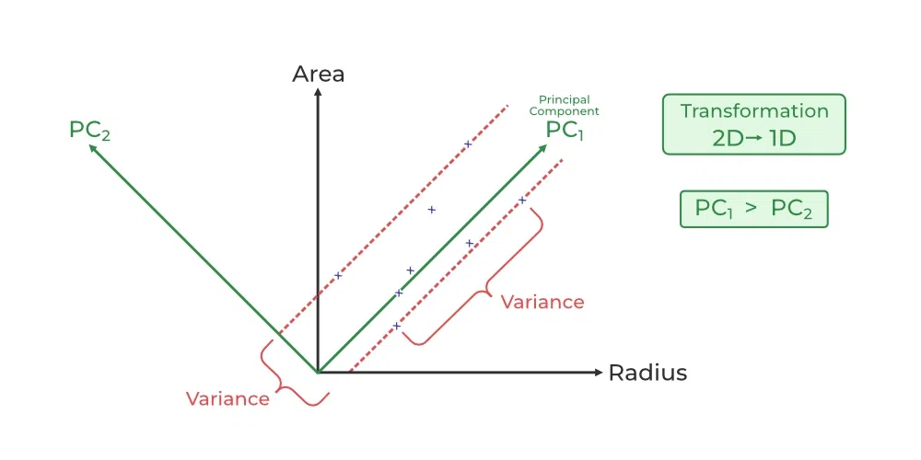
Principal component analysis
Dimensionality Reduction: PCA is used to reduce the dimensionality of the data (e.g., from 2D to 1D in this example) by focusing on the components that capture the most variance (PC1). This makes the data easier to analyze while minimizing information loss.
Feature Transformation:The data is reoriented along new axes (principal components), which are linear combinations of the original features.
Shabab Akhter | Ext. Lecturer | RUC

Slide 25
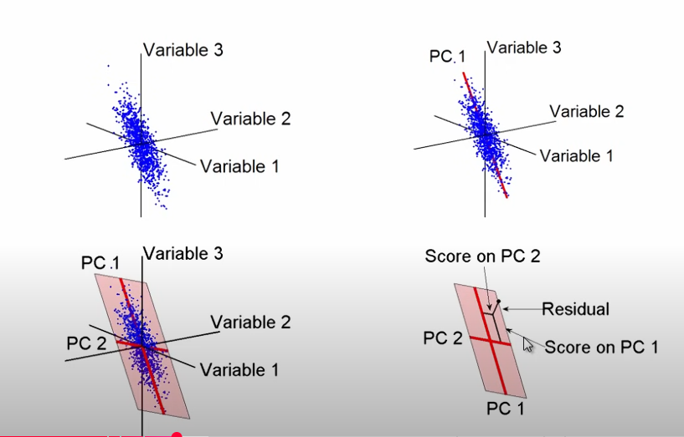
PCA – another example
Try to draw a straight line that capture most of the variance in the data
Then draw another line orthogonal to the first line that again captures most of the variance in the data
The two lines form a new 2D plane which is used as the new converted dataset
Shabab Akhter | Ext. Lecturer | RUC

Slide 26
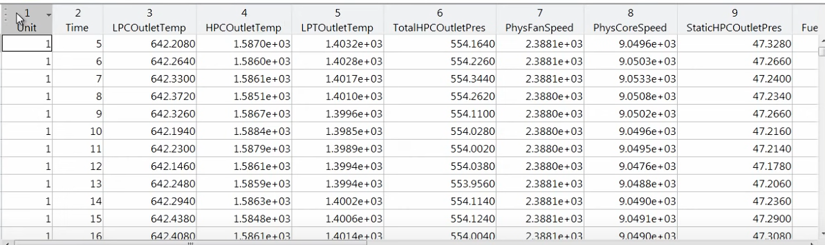
PCA in action
Dataset containing sensors values from sensors in a plane engine. There are a total of 14 sensors that are sending values every second. The goal is to be able to predict engine failure based on these sensor values.
The hard part: there are no labels!
Shabab Akhter | Ext. Lecturer | RUC

Slide 27
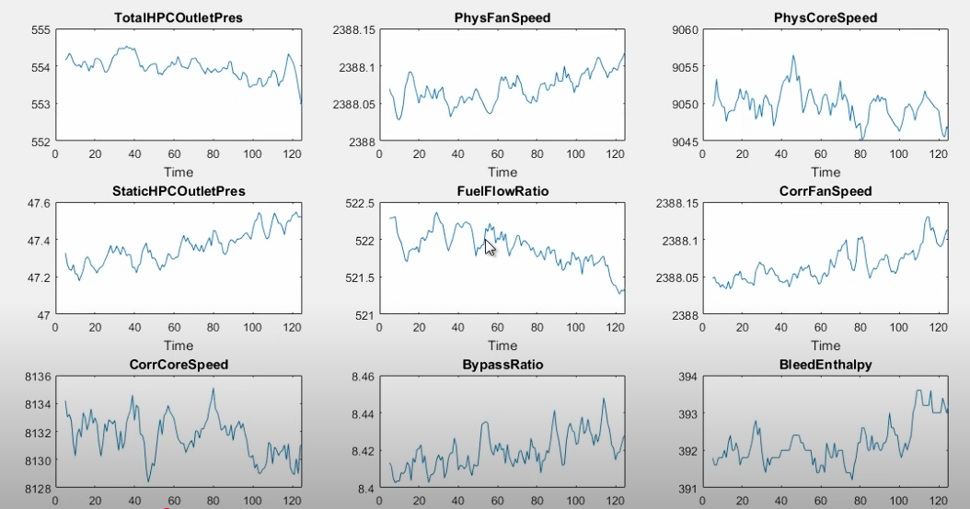
We start with EDA & visualizations (ofcourse)
Nice to see general view of the data and does give some insights – but can you really predict anything with this?
Shabab Akhter | Ext. Lecturer | RUC

Slide 28
We start with EDA & visualizations (ofcourse)
Nice to see general view of the data and does give some insights – but can you really predict anything with this?
Shabab Akhter | Ext. Lecturer | RUC

Slide 29
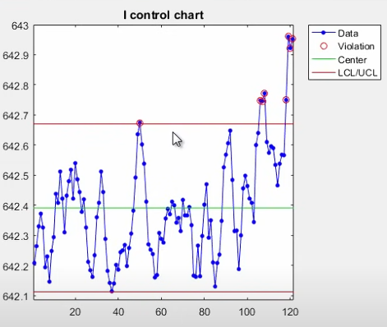
We can use control charts
Old school method but works very well if you have small datasets.
Concept is simple:
Find a control level, i.e. what are the most common values of the data
Anything below or under this means that something is potentially wrong
What do you think could be challenges with this method, particular to our dataset?
Shabab Akhter | Ext. Lecturer | RUC

Slide 30
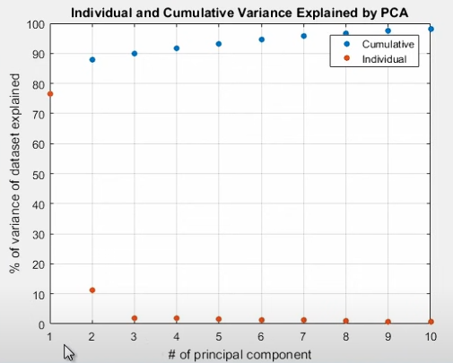
This is where we can apply PCA
After applying PCA, we can check how much of our variance is explained by each principal component.
More than 75% is explained with just one component instead of the 14 variables.
More than 80% explained by 4 components.
Shabab Akhter | Ext. Lecturer | RUC

Slide 31
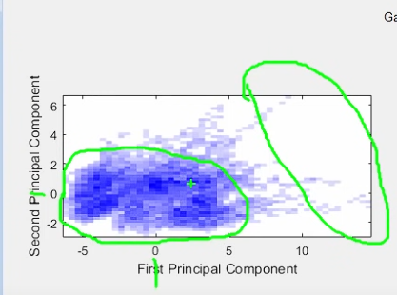
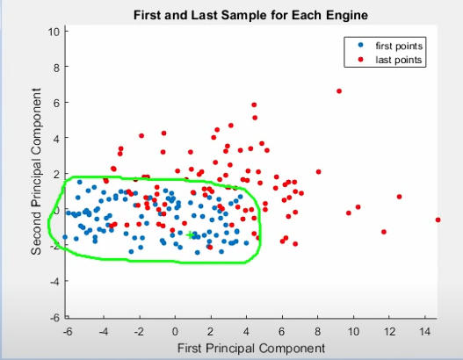
This is where we can apply PCA
After plotting principal components (3 components were selected), the graph gives valuable insights
We can validate our theory by visualizing the data points based on time
Shabab Akhter | Ext. Lecturer | RUC

Slide 32
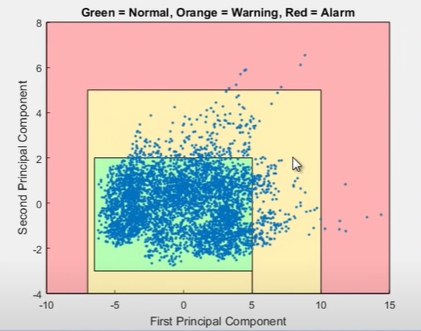
In the end, we can create something like this
Once we have this model, once new sensor values come in, we can get its principal components and put it in this plot.
Based on where the point(s) fall in this plot, we can decide if there is risk of engine failure
Shabab Akhter | Ext. Lecturer | RUC

Slide 33
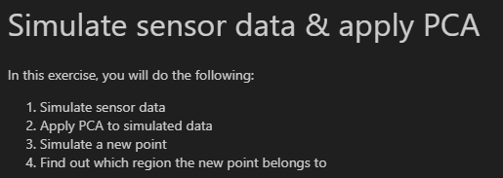
Exercise – try to do the same yourself
Shabab Akhter | Ext. Lecturer | RUC

Slide 34
Contents
Background & fundamentals of IoT & sensor data analysis
What is IoT?
What are the key challenges with IoT data?
Exercise - load sensor data and visualize
IoT Connectivity
Protocols
Data & Analytics
MQTT
Exercise on MQTT
Predictive maintenance
ML modelling for predictive maintenance
Evaluation metrics
Exercise - predictive maintenance modelling
Real world considerations
IoT infrastructure & Edge computing
Shabab Akhter | Ext. Lecturer | RUC

Slide 35
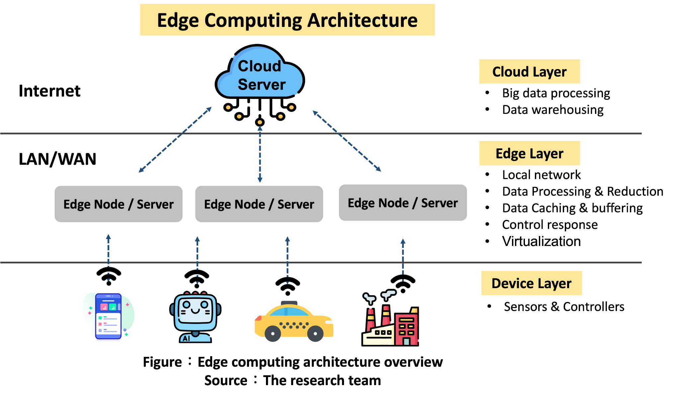
IoT and edge computing
IoT infrastructure refers to the hardware and software architecture that supports the deployment and management of IoT devices and sensors.
Edge computing refers to processing data closer to where it is generated (at the "edge" of the network), reducing reliance on cloud computing.
Shabab Akhter | Ext. Lecturer | RUC

Slide 36
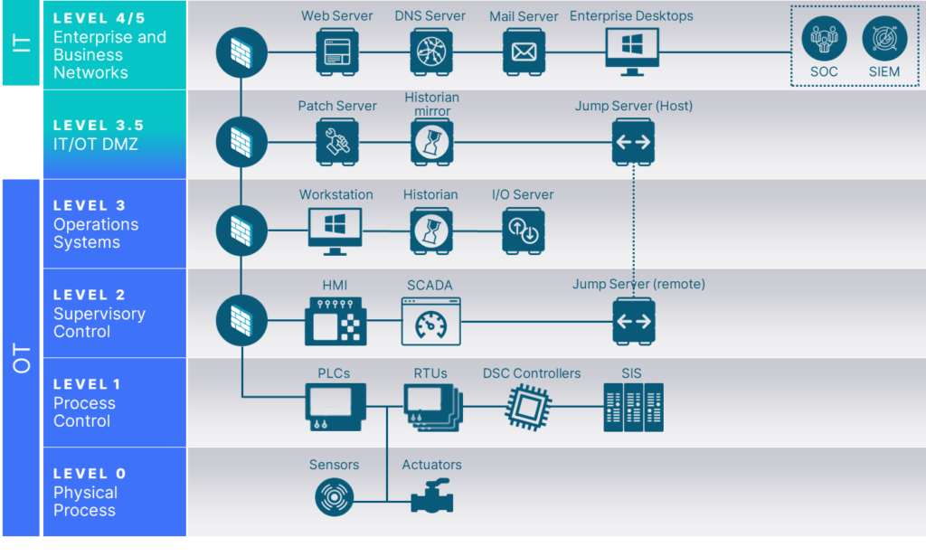
Industry standard – the Purdue model
Shabab Akhter | Ext. Lecturer | RUC

Slide 37


